Slide 1

Is Starbucks your cup of Coffee?
Project 3 Team:
Anita, Asel, Harshita, Ramya and Sneha

Slide 2
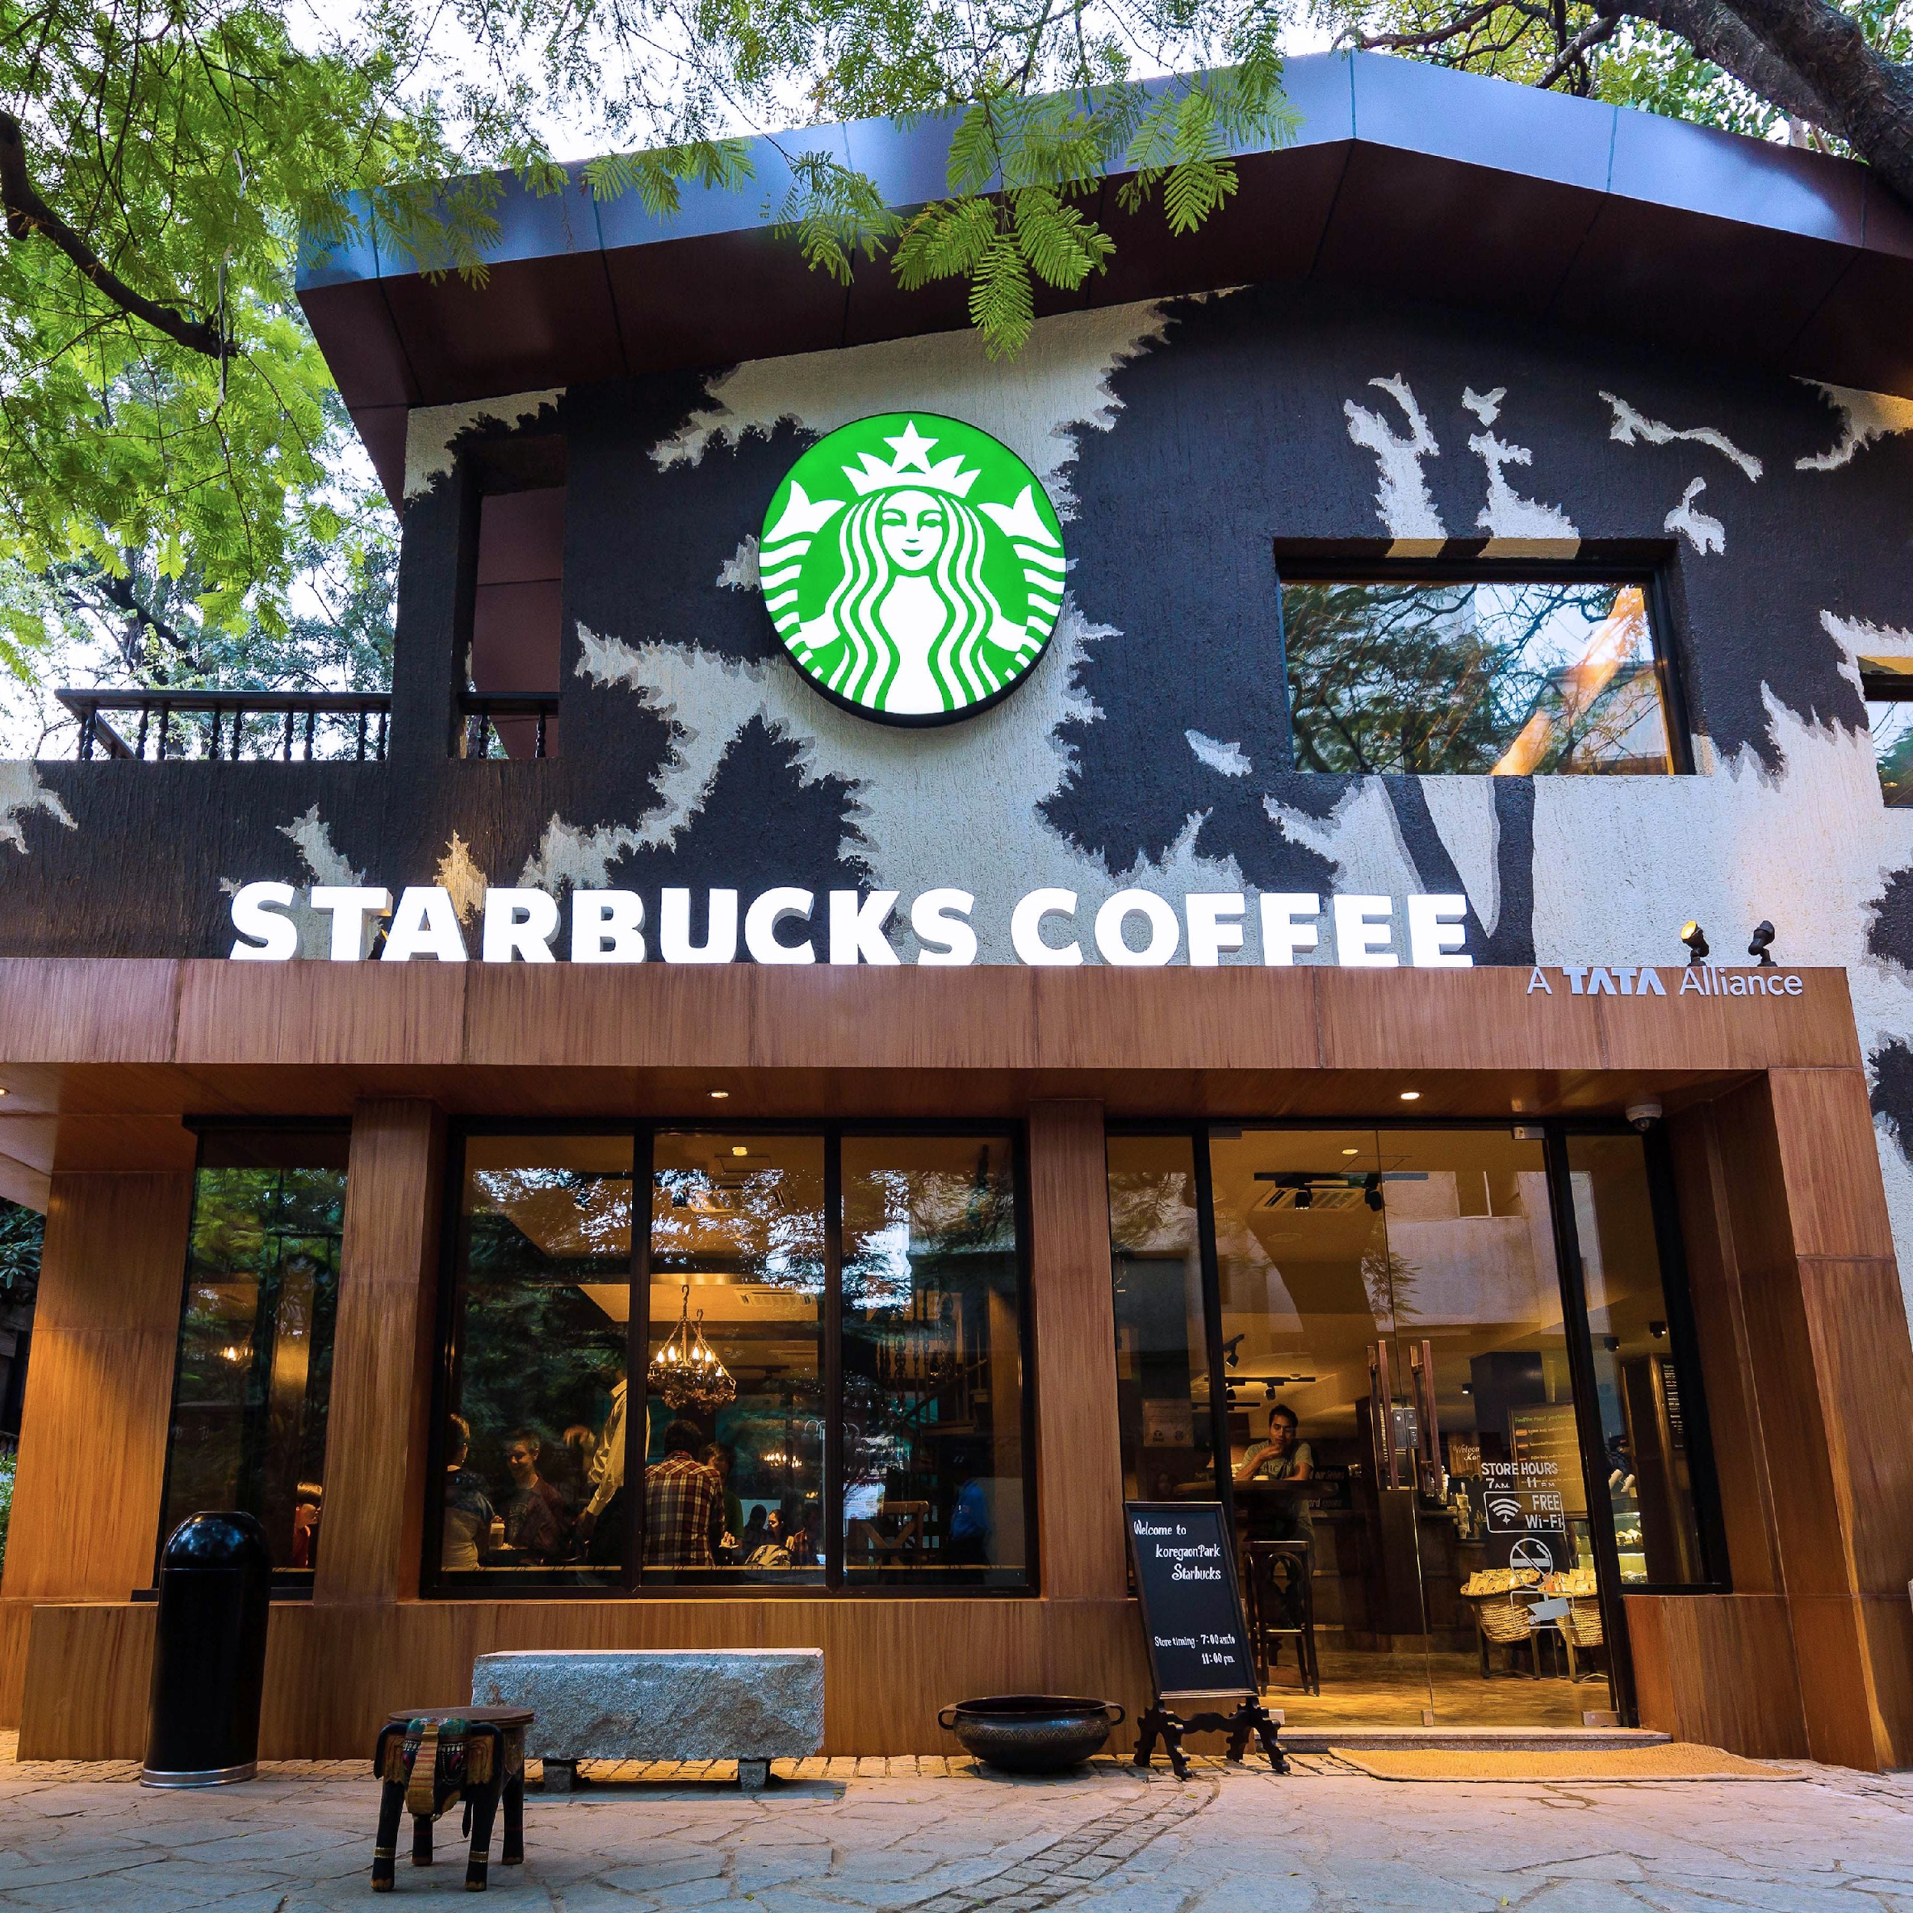
Table of Content
The Purpose of this Study
About Starbucks
Global and Local Presence
Starbucks Customer Profile
Nutrition
Conclusion

Slide 3

Who are we and why Starbucks?
We are a small non-profit coffee roastery, WOMEN COFFEE ROASTERS, based in North Carolina.
We produce high-quality coffee beans that offer unique taste and come in small batches and used in dark roast espresso drinks.
We are searching for a successful and long-term coffee shop/house that would craft a perfect cup of coffee and make a positive impact in consumers lives.
Hence, this project is to study one of our potential partners, the world's largest coffeehouse chain, Starbucks.

Slide 4
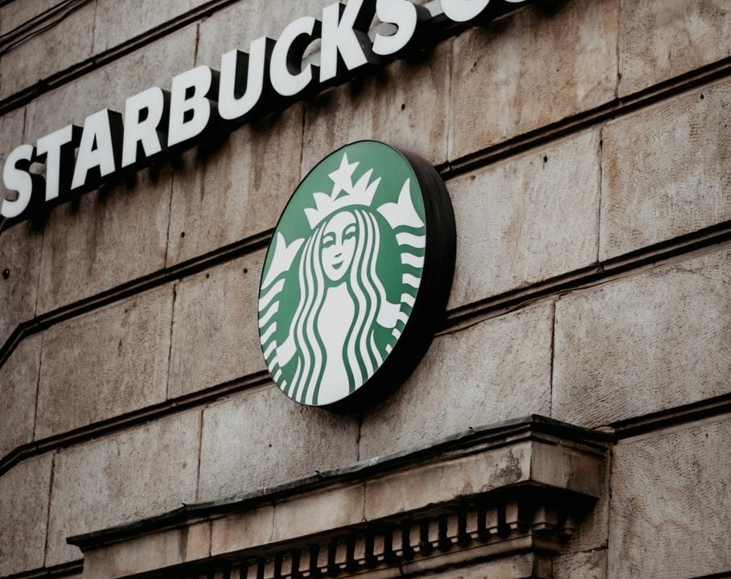
Evaluation criterion
We have 4 criteria in selecting our potential partner:
A partner should be able to craft our coffee within healthy sugar/caloric ranges.
Committed to ethically sourcing and roasting the highest quality coffee.
Global presence.
A partner with established customer market with reliable data.

Slide 5

Hypothesis
Starbucks has presence in every single country.
Women love Starbucks more.
The size of the beverages have a positive correlation with the sugar content and calories of the beverage.
At least 50 of Starbucks drinks will exceed the daily recommended value for Sugar.

Slide 6

The Purpose of this Study
In considering Starbucks for potential partnership, our team has conducted an analysis of Starbucks in following areas:
Global and local presence
Types of ownership
Average customer profile
Nutrition

Slide 7
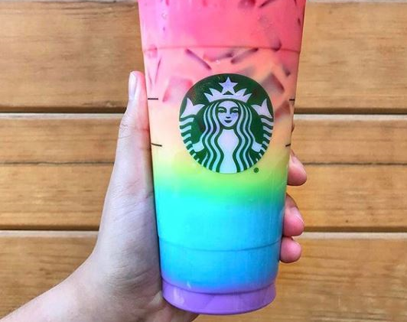
- It was founded by two teachers and a writer. - The most loyal 20% of customers come into the store at least 16 times per month. - There are over 87,000 drink combination possibilities. - The “trenta” sized cup holds more liquid than the human stomach.

Slide 8
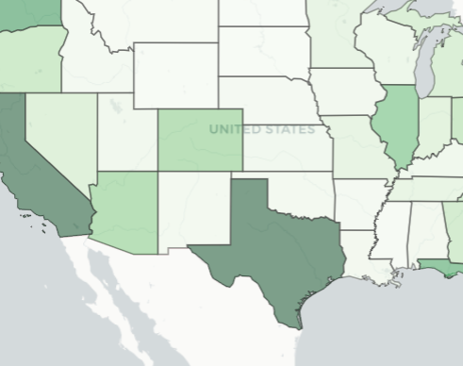
As of 2020, Starbucks had 32,660 stores in 83 countries, including 16,637 company operated stores and 16,023 licensed stores. Of these 32,660 stores, 18,354 are in the USA, Canada, and Latin America.

Slide 9
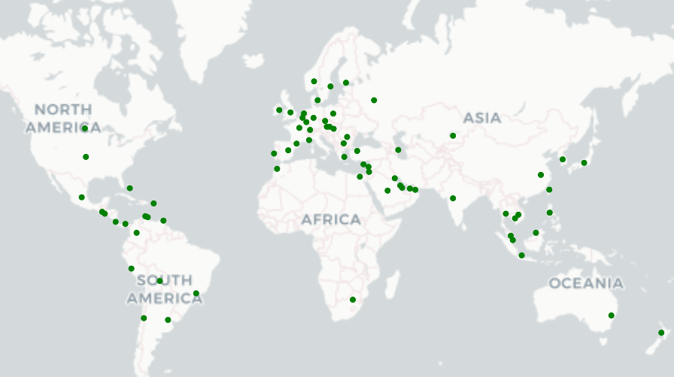
Starbucks has stores in over 70 countries around the world offering over 170,000 combinations of beverages.

Slide 10
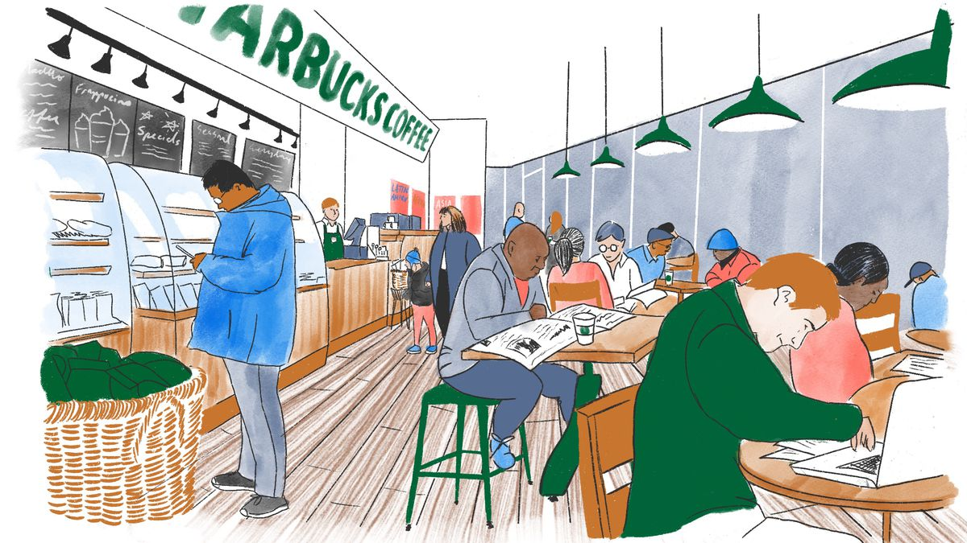
Who loves Starbucks more?

Slide 11
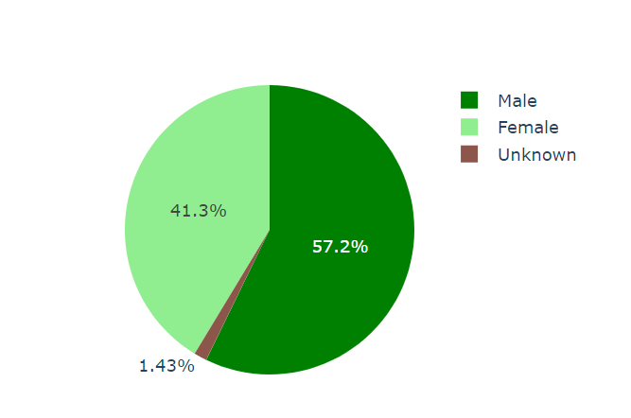
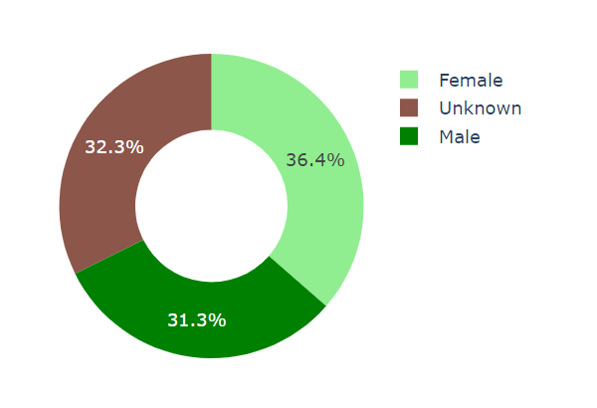
Customer Profile
Males love Starbucks more than women
Average income

Slide 12
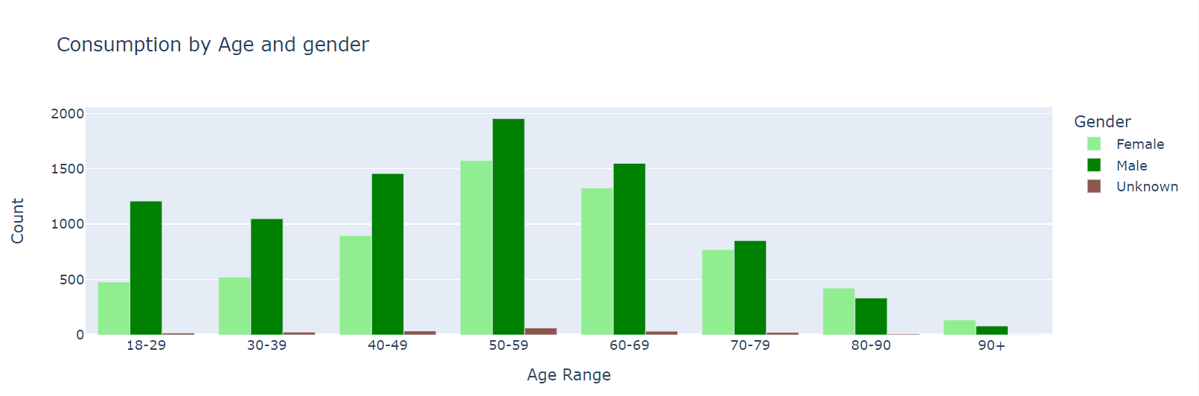
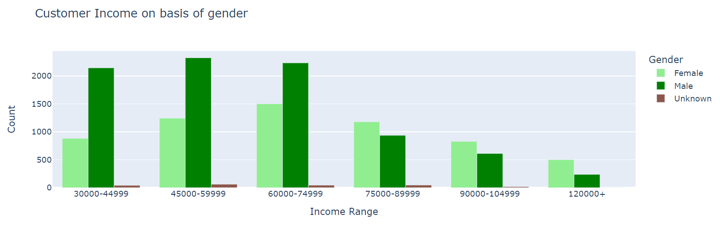
Majority of Starbucks customers make between 45k - 80k around minority are making more than 100k per year.

Slide 13
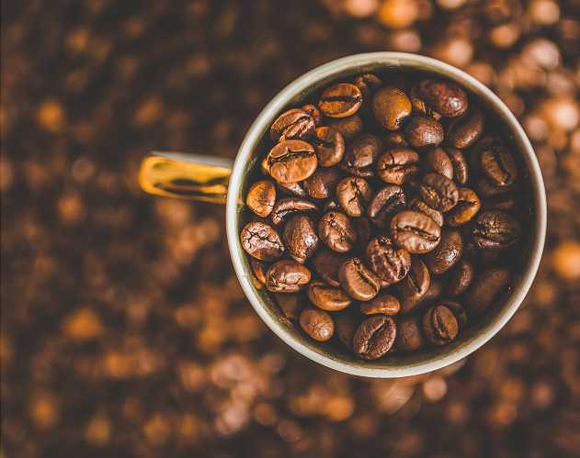
Nutritional Value

Slide 14
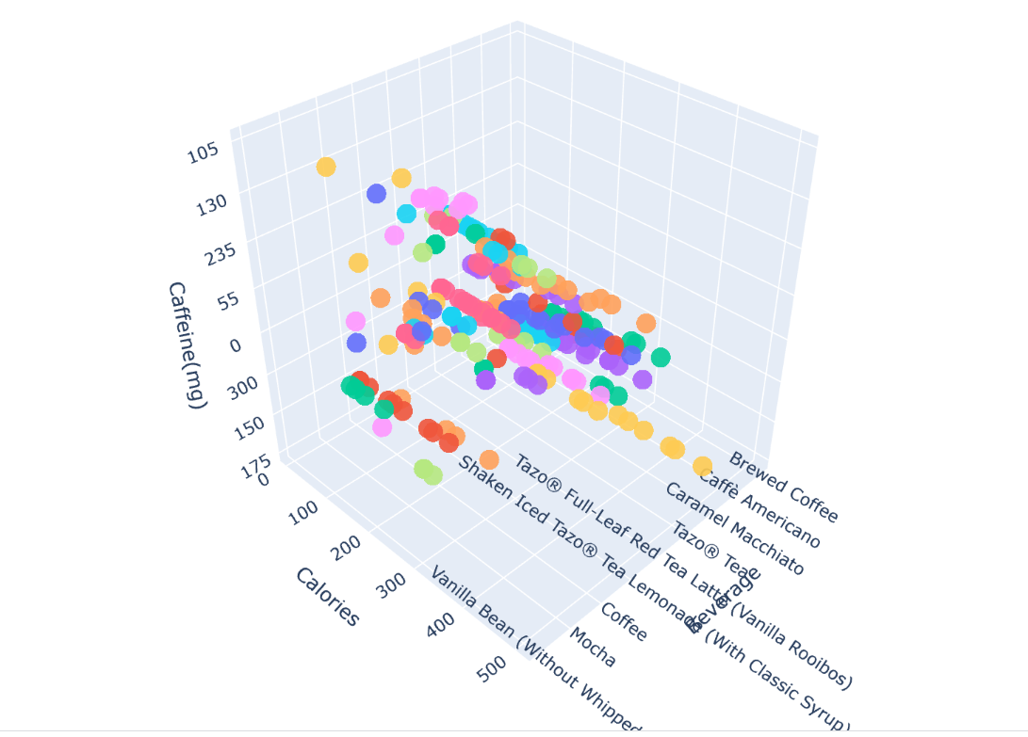
Starbucks Nutritional Values

Slide 15
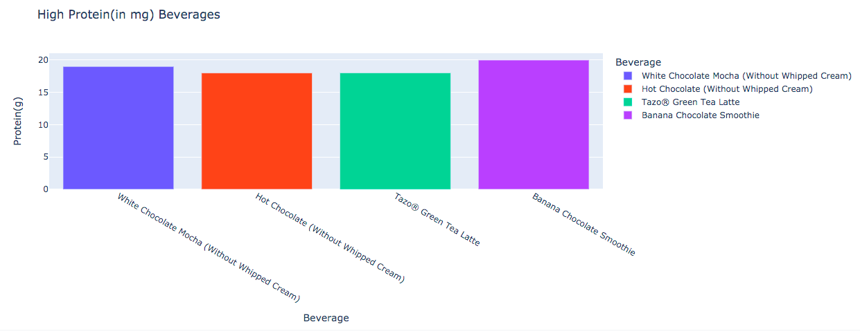
Starbucks Nutrition: Protein

Slide 16
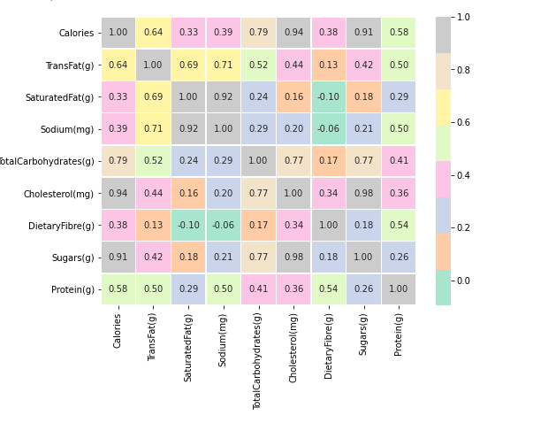

Slide 17
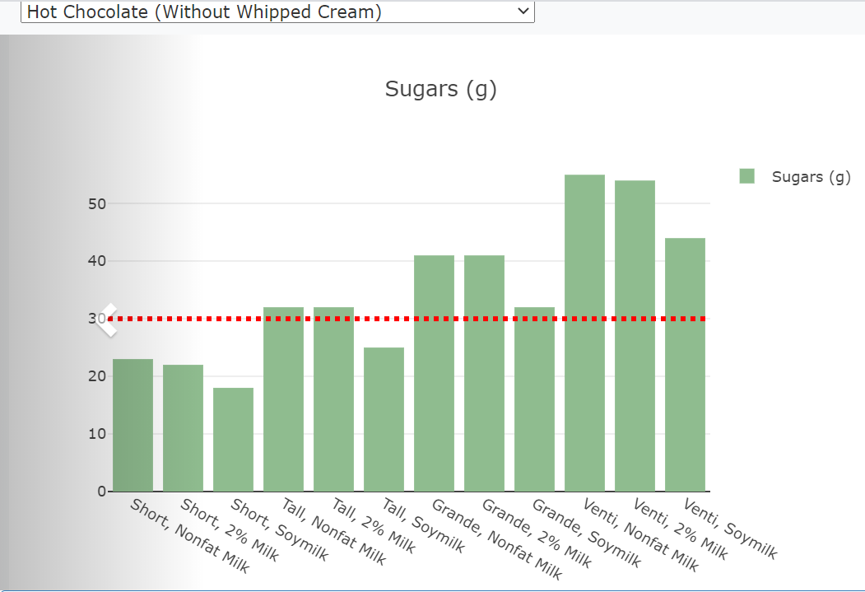
71% of Starbucks drinks of all categories of size Grande exceed daily recommended sugar amount which is 30grams/day.

Slide 18
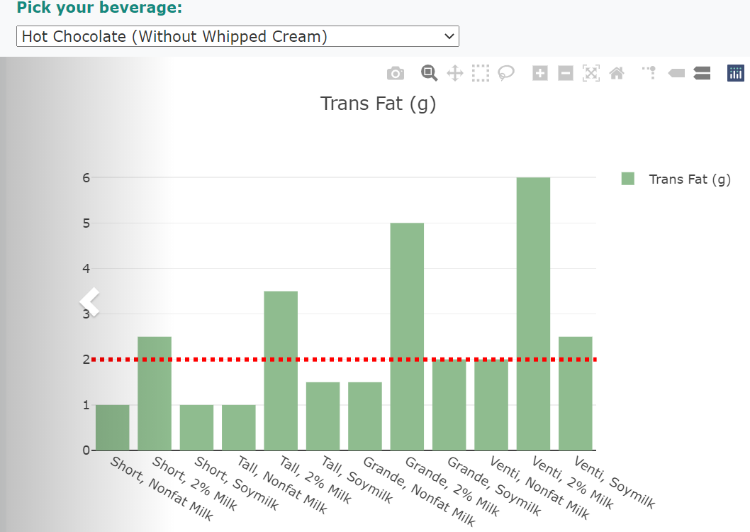
When enjoying the delicious drinks, one should be aware of some nutritional facts of each drink. For instance, the chart to the right shows the trans fat per grande sized of hot chocolate.

Slide 19
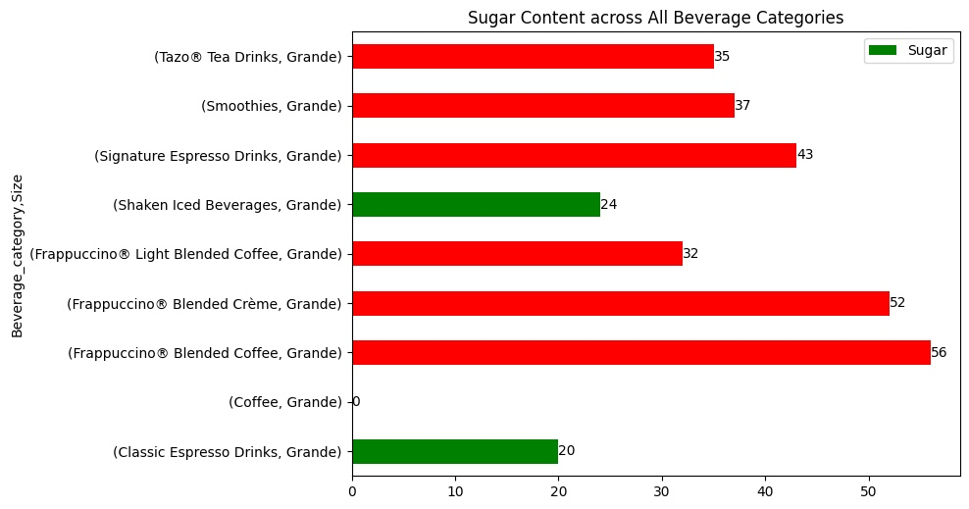
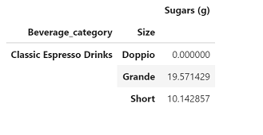
Sugar

Slide 20
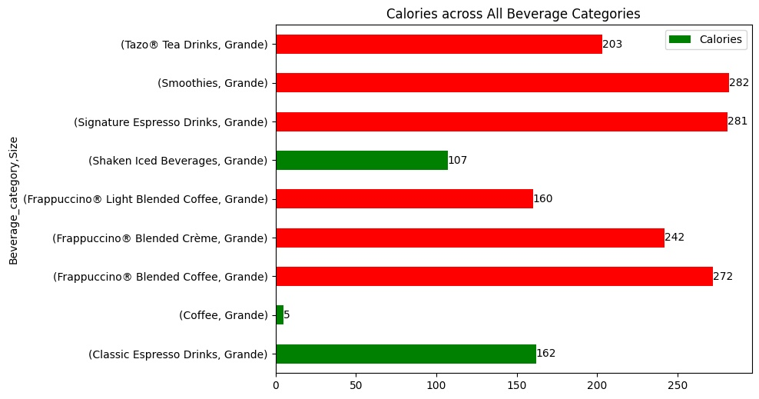

Slide 21
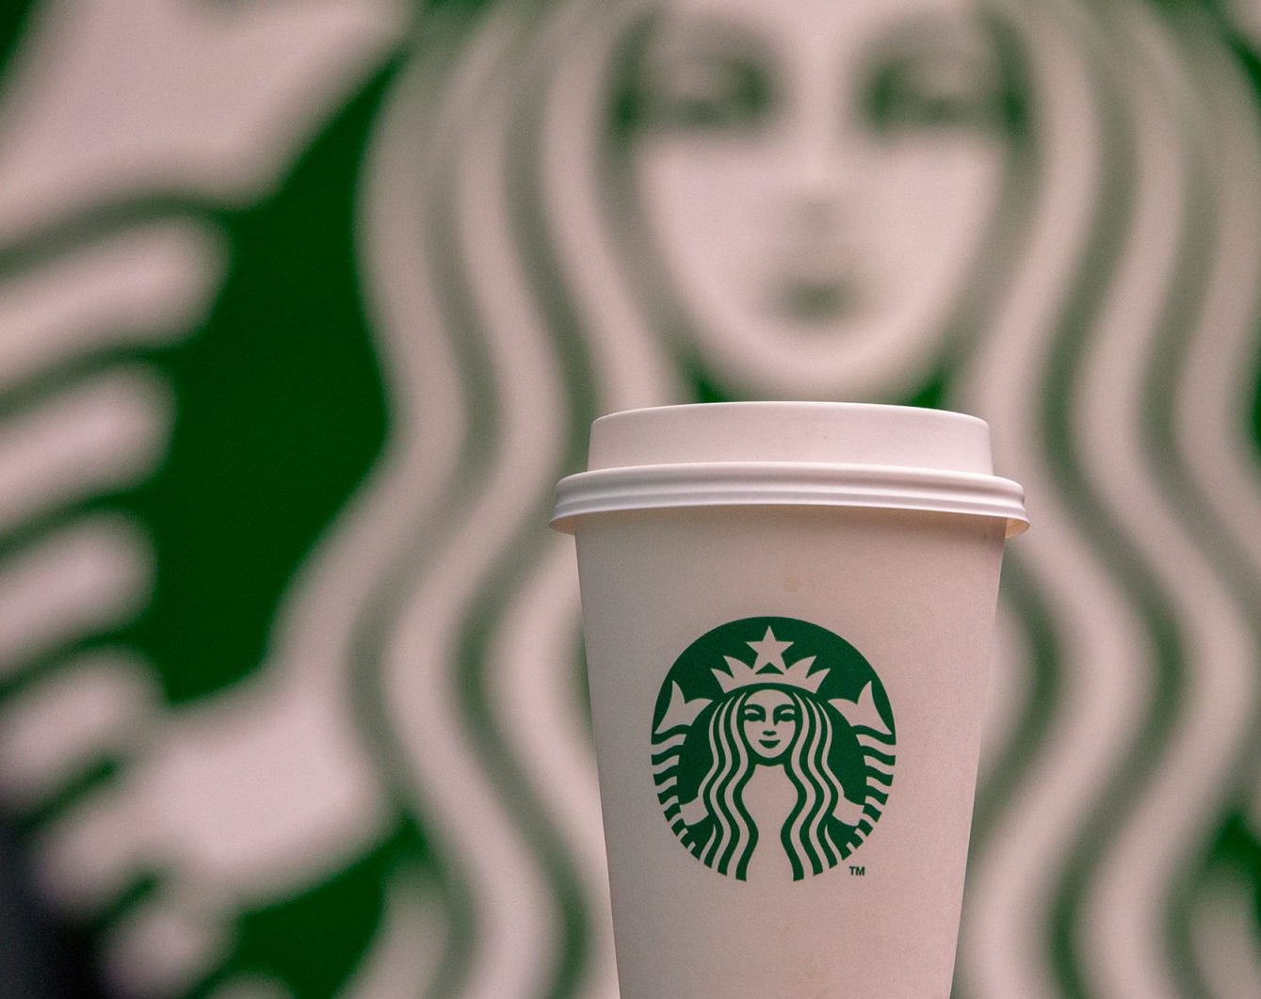
Conclusion
Starbucks is the largest global coffee house
Everyone loves Starbucks, mostly men
Starbucks offers over 170 thousand customized beverages
We also know that while the delicious lattes, mocha and hot chocolate drinks are extremely unhealthy in terms sugar, calories, cholesterol and trans fats, we found out that the espresso drinks where our coffee beans would be used as ingredient -- are the healthiest and have the lowest sugar.

Slide 22
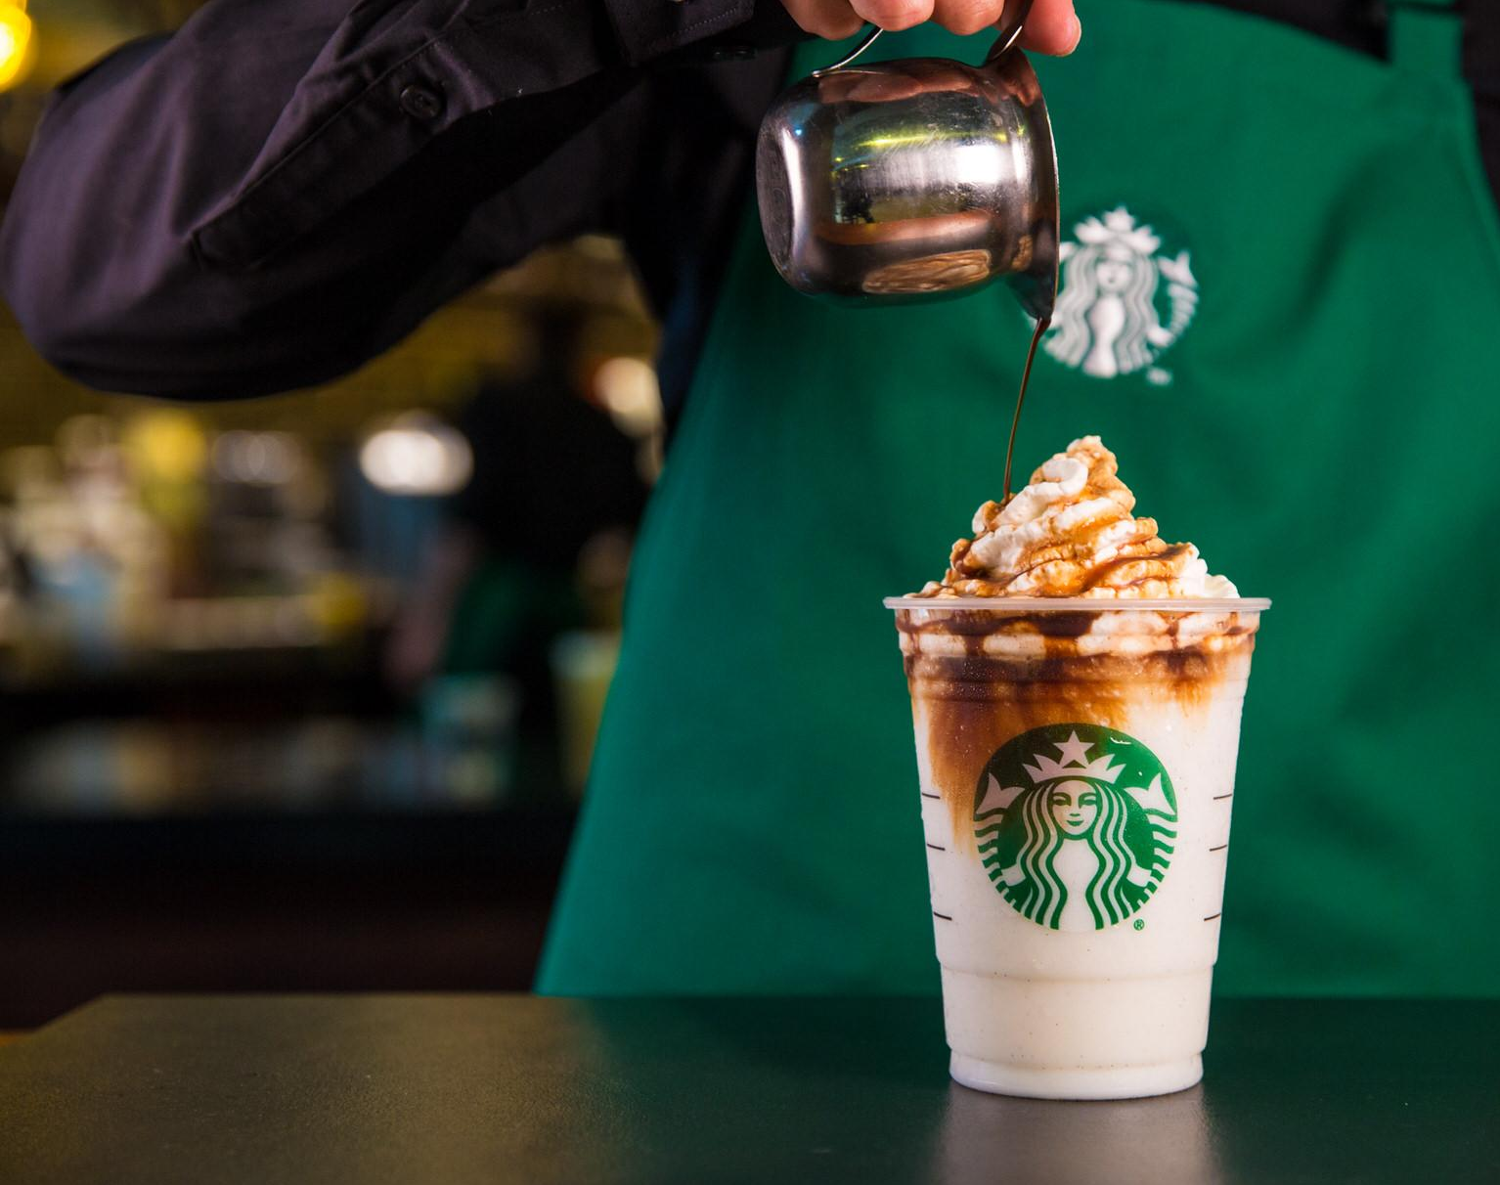
Project Repo & Resources
https://github.com/snehachada/Is_Starbucks_your_cup_of_coffee
Kaggle.com
Starbucks.com
heart.org

Slide 23
Thank you!

